Slide 1
Managing The Data Flow
From the Spring Of Ideas to the Pool of Knowledge
Robert Olendorf
Zoe Chao
Amy Jackson
University Libraries
University of New Mexico
LITA National Forum
October 1, 2011
New Yorker - 09/25/06

Slide 2
Six Short Stories
About Data, Data Sharing, Data Stealing and Data Discovery and Scientific Discovery

Slide 3
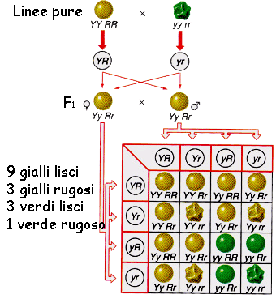
Mendel’s Data
Cultivated 29,000 pea plants from 1856-1863
Work was initially rejected and not understood
Very statistical – a new field at the time
Darwin was aware of Mendel’s work but failed to recognize the significance to his work
Mendel’s theory solved many of Darwin’s problems
Darwin held with blended inheritance
Mendel’s work on other organisms didn’t work so well.

Slide 4
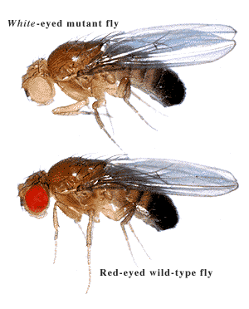
Mendel’s Data – The Modern Synthesis
Thomas Morgan rediscovered Mendel’s work (1900), verified with fruit flies
Developed Genetic Linkage mapping
Morgan was awarded the Nobel Prize in 1933
R.A Fisher and others rediscovered and replicated Mendel’s work (circa 1918)
R. A. Fisher and Sewall Wright applied and extended Mendelian Genetics to
Quantitative Genetics
Evolutionary Biology

Slide 5
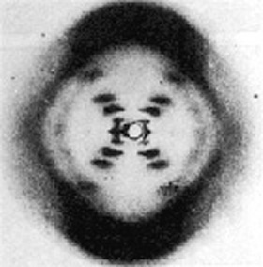
The Structure of DNA
1953 Watson and Crick published the first correct model of DNA in Nature
Based on a single X-ray diffraction image taken by Rosalind Franklin in 1952 and information gleaned from other researchers. Watson and Crick didn’t generate data
Franklin and others preferred an alternative structure
Solved problems concerning how Mendelian inheritance worked.
Watson and Crick were awarded the Nobel Prize in 1962

Slide 6
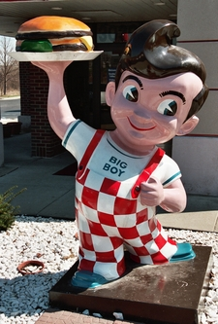
Magnetic Resonance Imagining (MRI)
1962 Paul Lauterbur, a graduate student
Sees a talk about Nuclear Magnetic Resonance on Cells
Imagines applying NMR to a hamburger at a local big boy.
Scribbles his first ideas on a napkin.
1970’s first working MRI imaging machines are made
2003 Lauterber is awarded the Nobel Prize

Slide 7
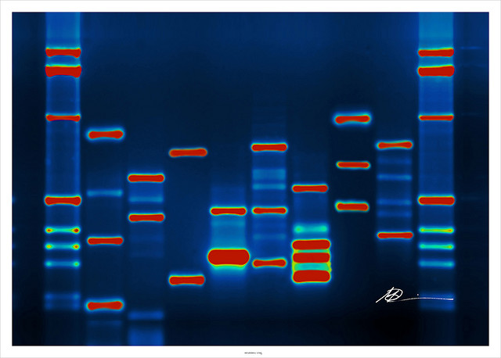
National Center for Biotechnology Information – GenBank
Started in 1979 at LANL as the Las Alamos Sequence Database
1992 Transitioned to NCBI
As of April 5, 2011 108,431,692 DNA Sequences
135,440,924 DNA Sequences records as of June 9, 2011

Slide 8
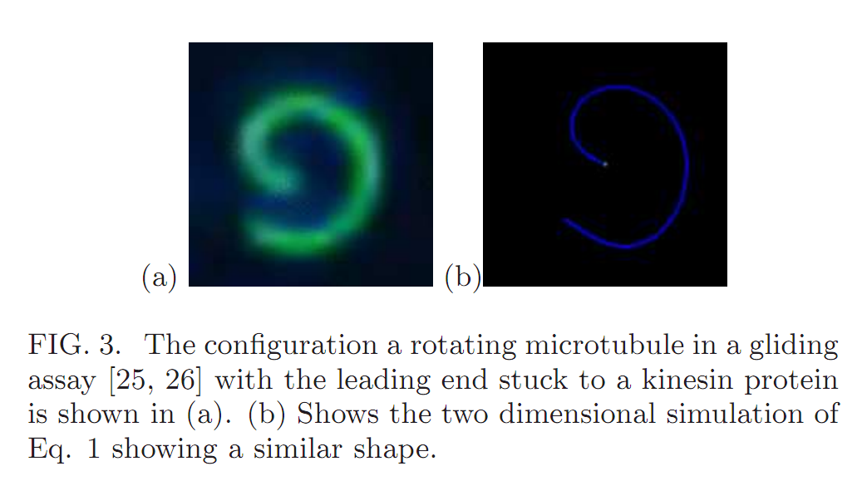
Kinesin Gliding
Steve Koch starts making his data freely available on his own web server
He also posts some videos of his work on youTube
Another reseascher in drosophila (fruit fly) molecular embryology is looking for images and stumbles across Koch’s youTube video
Calls are made, data explained and the drosophila researcher realizes that some garbage data of Koch’s actually explains some of his results
This happened with no metadata, no curation, no archiving
Papers are written
No Nobel Prize is expected
From
http://arxiv.org/PS_cache/arxiv/pdf/1101/1101.2225v1.pdf
http://www.youtube.com/user/KochLab#p/a/u/0/heaK44PW5ko
http://www.kochlab.org/files/Passivation/

Slide 9
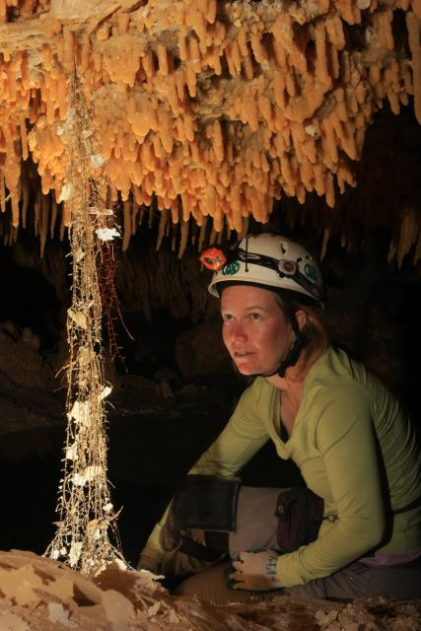
Cave and Exo- Microbiology
Her Data
Scanning Electron Micrographs
Light Microscopy
Spectroscopy
Standard Photography
Locations
Chemical and Biochemical Analysis
http://idec.aisti.org/

Slide 10
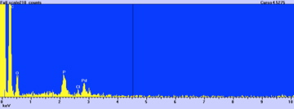
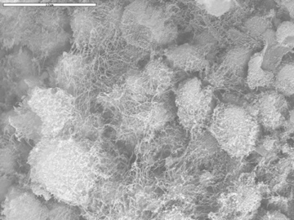
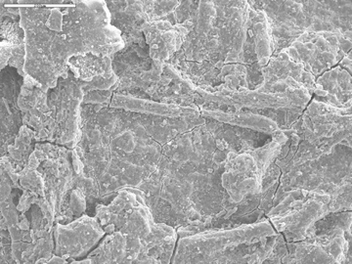
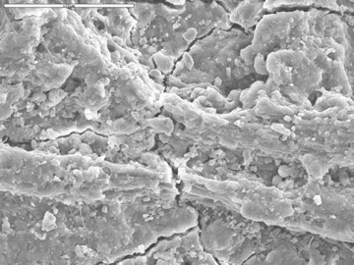
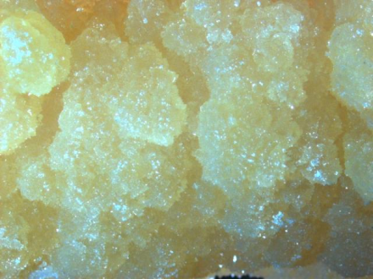
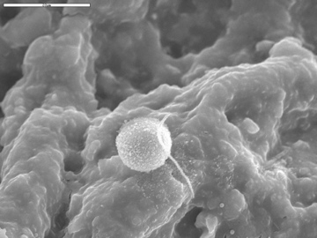
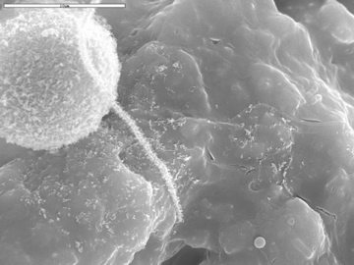
Implied Data Structure

Slide 11
Analysis

Slide 12
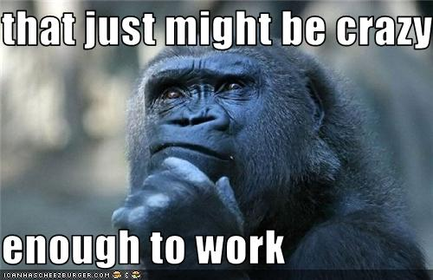
Lessons Learned
People make discoveries not computers
We should maximize intersections between people, ideas and data
Facilitate collaboration as well as data interoperability
Great Discoveries can be…
Serendipitous
Quirky
Unpredictable
Borrow from different disciplines
Even “garbage data” might be useful
The data must still exist
Making data cross disciplinary boundaries is good

Slide 13

Lessons Learned cont.
Researchers have been publishing and finding “shared” data for a long time
Researchers will work to archive data if…
They are protected
It increases their publication rate
Increases their funding rate
Data counts toward tenure and promotion

Slide 14
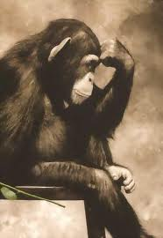
Lessons Learned cont…
To Be Useful Data Must
Exist
Be Findable
Be Understandable
Be Open
…?

Slide 15
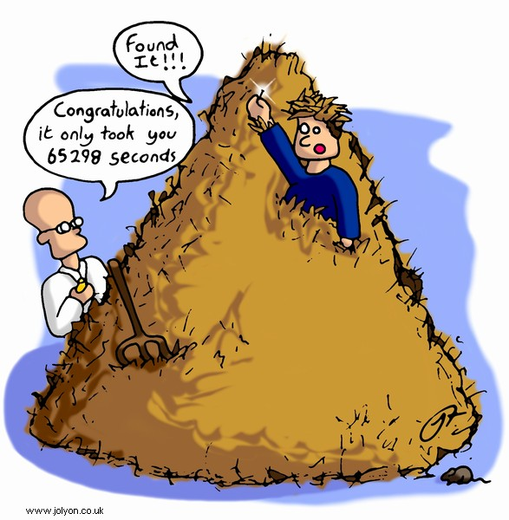
The Data Deluge
Finding data can be time consuming – even if you know your looking for a needle
How would one find a needle in a haystack, when you don’t even know you are looking for a needle?

Slide 16
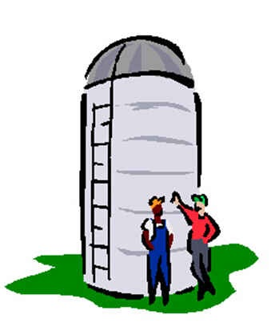
Data Repositories are Silos
Even if we try to make repositories open, we often must know that the silo exists
An increasing number of repositories –
2009 – 1,170 Molecular Biology Databases
Repository Deluge?

Slide 17
Data is Often Complex
Steve Koch’s and Andy Maloney’s data
500 GB for one experiment
Currently 500 GB of storage in the UNM repository
500, 000 files in complex file structure
Currently 8060 files in the UNM in repository
Structural Metadata is ~5 million lines of XML
Complex image analysis algorithms
To understand his data takes a lot of time.
Big Complex data is common even in small science

Slide 18
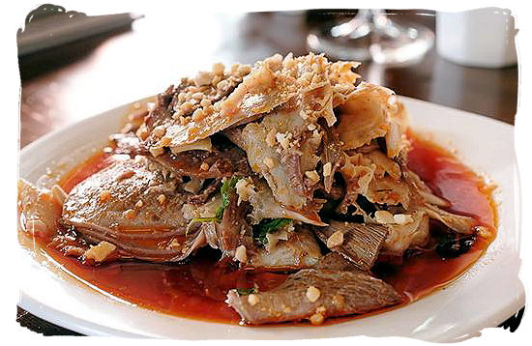
We Can’t Predict What Will Be Wanted
Even “garbage” data might be useful
Misunderstood data might be underestimated
Even bad data can be instructive – prevent similar mistakes
Spicy Pig’s Intestines

Slide 19
UNM Libraries Role

Slide 20
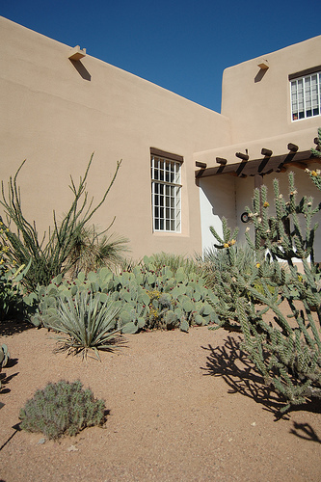
UNM’s Commitment to data
Take Academic Output
Of any type
From any domain (Architecture – Zoology)
Annotate Data
As completely as possible
With as little effort by the researcher
Using domain specific standards where possible
Archive data
As is
For the life of the institution (for a long time)

Slide 21
UNM’s Resources
Personel
5 Data Librarians with domain expertise
Natural Sciences, Geo-spatial, Humanities & Social Sciences, Business and Economics and Engineering
2 Digital Repository Librarian
1 Metadata Librarian
IT Support
Limited to DSpace for the moment
much more on line by the fall
Financial
LIMITED
We do have the support of the higher administration

Slide 22
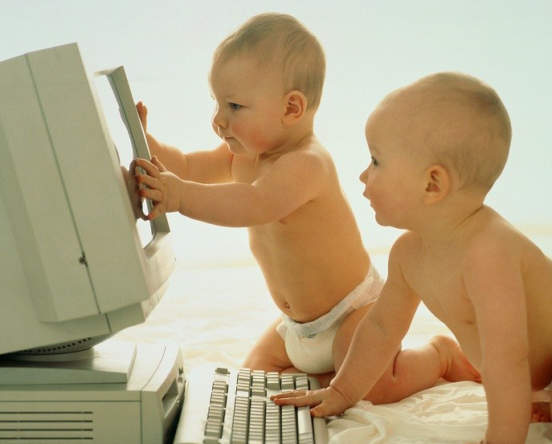
Role of Data Librarian
Data Management Plans
NSF, NIH and NEH require them
Some private agencies require them
Usually straight forward, not always
Rights Management
Licensing of faculty products
Managing license for reused resources
Data Management
Consult with researchers to better manage data
Develop systems to better handle data

Slide 23
Role of Data Librarian
Data Curation
Work early with researchers to record metadata
Encode research data into standard based schema
Collaboration with Faculty
Create Portals for Research and Data
Develop better methods for data creation and entry
Enhance Quality Assurance workflows
…

Slide 24
Test Cases
Molecular Physics
Committed to Open Data
Big, Complex Data
Data grant submitted
Cave Microbiology
Interested in Data for Education
Complex Data of Modest size
Data grant submitted
High Density EEG – Psychology
Big, Complex Data
Hard to get data
Astronomical Observations
Legacy
Modern
Motivated faculty with strong, curated and complex data sets
Already have instances of discoveries from sharing
Demonstrated value
Provides upper end for us to design around
Start with success
This is our high hanging fruit (slow moving meat?)

Slide 25
Good Things About DSpace
Provides Stable URL
Allows Google Indexing
Search and retrieval of files
OAI
Tracking of views and downloads
We have it already

Slide 26
Limitations of DSpace
Designed primary for single documents and files
Lack of support for hierarchical metadata schemas
Lack of support for basic administrative functions such as:
Adding fields to simple item record and creating field labels
Mapping custom metadata to OAI-PMH export
Mapping and indexing custom fields to searchable indexes
(These are doable with our developer, but not we don’t have a dedicated DSpace Developer)

Slide 27
System Overview

Slide 28
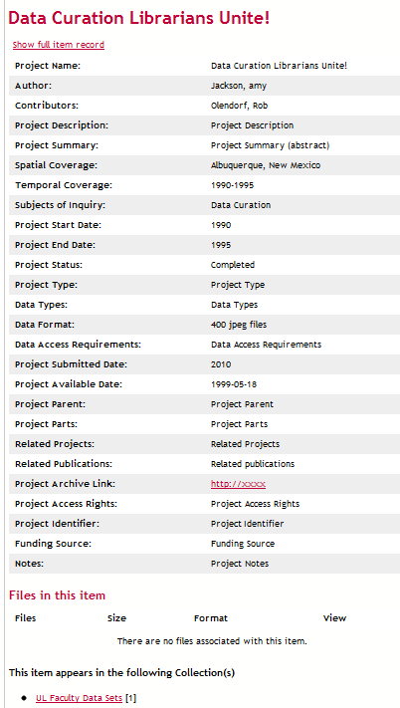
DSpace Metadata Record

Slide 29
Packaging - Metadata
XFDU
Developed by CCSDS at NASA
A structural metadata standard
A container for all other metadata
Can recursively contain other XFDUs
Premis
Preservation Metadata
Developed by the Library of Congress
Automating much of the process
Allows us to handle very heterogeneous data

Slide 30
Example Data Model
XFDU - File
XFDU - Directory
Premis
XFDU – PDI Meta
OME
Premis
XFDU – PDI Meta
XFDU - Descriptive
OME
XFDU - Descriptive
LOM
XFDU - Behavior
XFDU - Software
XFDU - Directory
XFDU - Behavior
XFDU - Software
Premis
XFDU – PDI Meta
OME
XFDU - Descriptive
XFDU - Behavior
XFDU - Software

Slide 31
Other Metadata
Dublin Core (req)
Rights Metadata
Technical Metadata
Mix
PBCore
…
Domain Metadata
GIS
DarwinCore
Ecological Metadata Language
Open Microscopy Environment
MathML
…

Slide 32
A Strategy for Data
Adding services to link to other services
websites etc. will facilitate data reuse and
discovery

Slide 33
Final Comments
The Now
The Future
We are aiming for hight
Level of data complexity
Level of reward
We hope to increase researcher by-in by providing services that enhance their careers
Curate and archive data to
Maximize Understandability
Minimize Risk of Loss
With Limited Resources
Funding to realize these goals
Move to a more Linked Data Environment
Replace current DSpace with a repository system more amenable to complex data

Slide 34

Thank You Questions?
Robert Olendorf
Research Data Librarian
University of New Mexico
Email: olendorf@unm.edu

